Slide 1
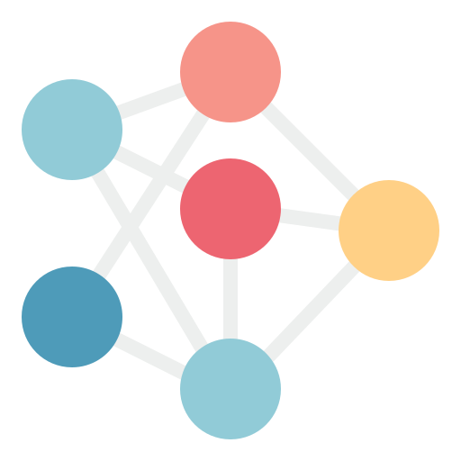


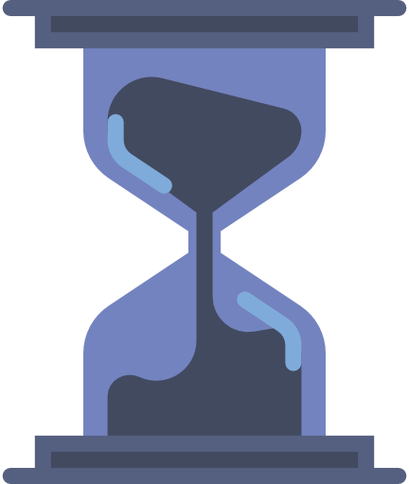

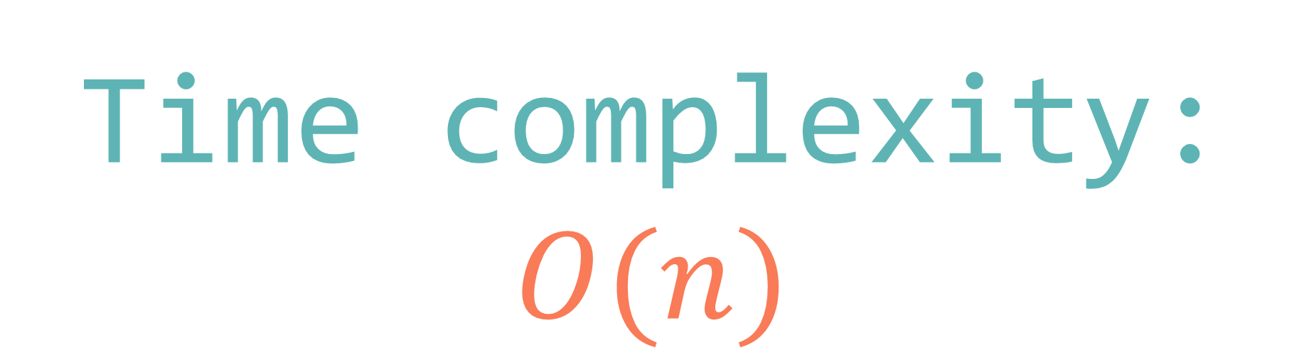

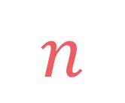
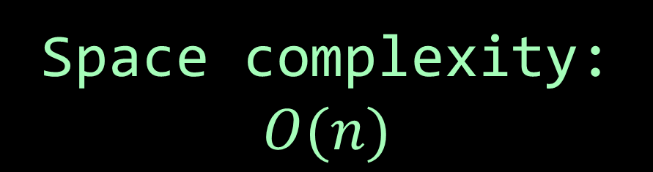
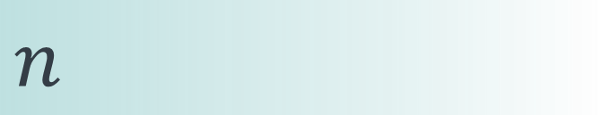
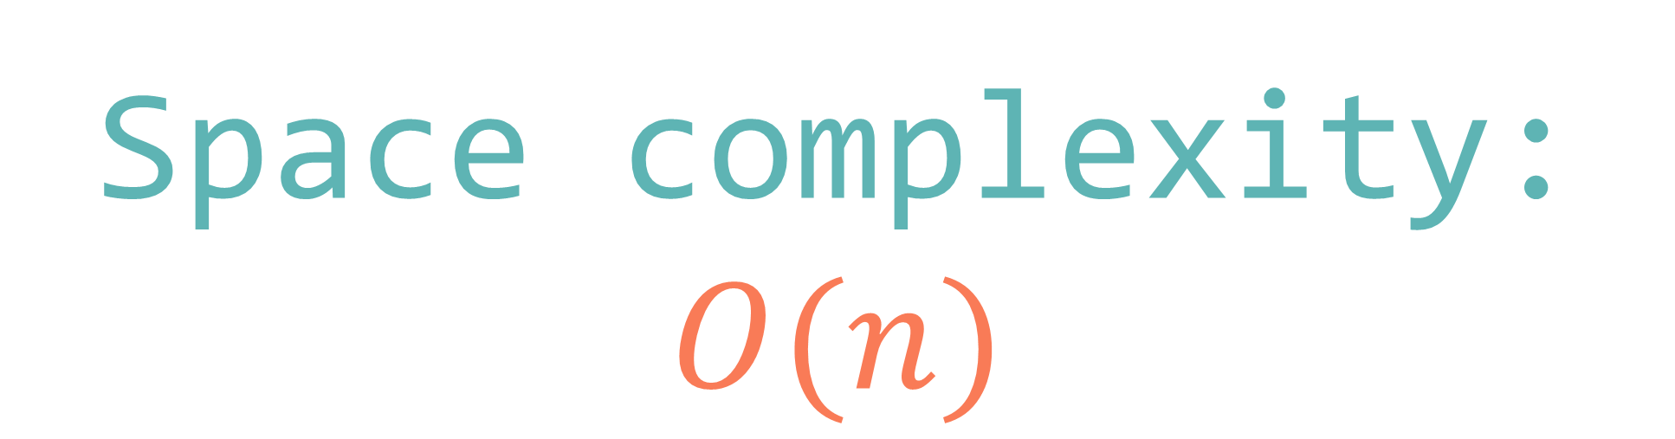
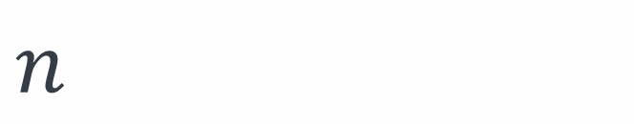
left
[4, 5, 1, 7, 2, 6, 3, 8]
no margin
Space complexity:
$$O(n)$$
list
list
list
list
mid
no margin
"string"
4 | 5 | 1 | 7 | 2 | 6 | 3 | 8
Space complexity:
$$O(n)$$
5
5
$
5
rec(n)
$$n$$
5
$$n$$
$$⇒$$
$$n$$
Time complexity:
$$O(n)$$
text
text
 |  |  | a
$$n$$
text
text
no margin
no margin
no margin
no margin
no margin
no margin
no margin
no margin

Slide 2

Ways to decode
512810120129
m

Slide 3
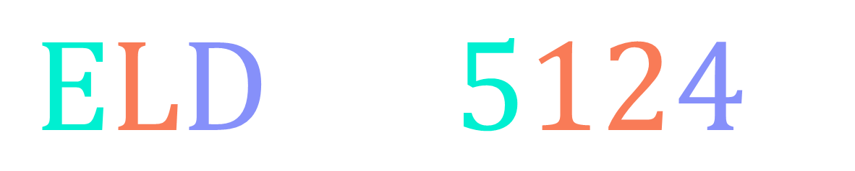
$$\text{E}\text{L}\text{D}→5124$$
because E is the 5th letter in the alphabet, L is the 12th letter, and D is the 4th letter

Slide 4







1 → A 2 → B 3 → C 4 → D 5 → E 6 → F 7 → G 8 → H 9 → I 10 → J 11 → K 12 → L 13 → M
14 → N 15 → O 16 → P 17 → Q 18 → R 19 → S 20 → T 21 → U 22 → V 23 → W 24 → X 25 → Y 26 → Z
$$"5124"$$
$$5 1 2 4$$
$$5 12 4$$
$$5 1 24$$
$$\text{EABD}$$
$$\text{ELD}$$
$$\text{EAX}$$

Slide 5

Given a string s made of numeric characters, find the number of ways to decode it by using the following table:
1 → A 2 → B 3 → C 4 → D 5 → E 6 → F 7 → G 8 → H 9 → I 10 → J 11 → K 12 → L 13 → M
14 → N 15 → O 16 → P 17 → Q 18 → R 19 → S 20 → T 21 → U 22 → V 23 → W 24 → X 25 → Y 26 → Z
$$\text{"}\text{0}\text{"}≤s\left[i\right]≤\text{"9"} \\ \left|s\right|≥1$$

Slide 6
1 → A 2 → B 3 → C 4 → D 5 → E 6 → F 7 → G 8 → H 9 → I 10 → J 11 → K 12 → L 13 → M
14 → N 15 → O 16 → P 17 → Q 18 → R 19 → S 20 → T 21 → U 22 → V 23 → W 24 → X 25 → Y 26 → Z
input:
s = "512810120129"
output: 4
explanation: ways to decode s are:
5 1 2 8 10 1 20 1 2 9
5 1 2 8 10 1 20 12 9
5 12 8 10 1 20 1 2 9
5 12 8 10 1 20 12 9

Slide 7
input:
s = "512810120129"

Slide 8
input:
s = "512810120129"
5

Slide 9
input:
s = "512810120129"
1
5
12

Slide 10
input:
s = "512810120129"
1
5
12

Slide 11
input:
s = "512810120129"
1
2
5
12

Slide 12
input:
s = "512810120129"
1
2
8
5
12

Slide 13
input:
s = "512810120129"
1
1
2
8
10
5
12

Slide 14
input:
s = "512810120129"
1
1
2
8
10
5
12

Slide 15

input:
s = "512810120129"
1
1
2
8
10
5
12

Slide 16
input:
s = "512810120129"
1
1
2
8
10
5
12

Slide 17
input:
s = "512810120129"
1
1
2
8
1
10
12
5
12

Slide 18
input:
s = "512810120129"
1
1
2
8
1
10
12
5
12

Slide 19
input:
s = "512810120129"
1
2
1
2
8
1
10
20
12
5
12

Slide 20
input:
s = "512810120129"
1
2
1
2
8
1
10
20
12
5
12

Slide 21
input:
s = "512810120129"
1
2
1
2
8
1
10
20
12
5
12

Slide 22
input:
s = "512810120129"
1
2
1
2
8
1
10
20
12
5
12

Slide 23
input:
s = "512810120129"
1
2
1
2
8
1
1
10
20
12
12
5
12

Slide 24
input:
s = "512810120129"
1
2
1
2
8
1
1
10
20
12
12
5
12

Slide 25
input:
s = "512810120129"
1
2
1
2
8
1
1
2
10
20
12
12
5
12

Slide 26
input:
s = "512810120129"
1
2
1
2
8
1
1
2
9
10
20
12
12
5
12

Slide 27

input:
s = "512810120129"
1
2
1
2
8
1
1
2
9
10
20
12
12
5
12

Slide 28
input:
s = "512810120129"
1
2
1
2
8
1
1
2
9
10
20
12
12
5
12

Slide 29
input:
s = "512810120129"
1
2
1
2
8
1
1
2
9
10
20
12
9
12
5
12

Slide 30
input:
s = "512810120129"
1
2
1
2
8
1
1
2
9
10
20
12
9
12
5
12

Slide 31
input:
s = "512810120129"
1
2
1
2
8
1
1
2
9
10
20
12
9
12
5
12

Slide 32
input:
s = "512810120129"
1
2
1
2
8
1
1
2
9
10
20
12
9
12
5
12

Slide 33
input:
s = "512810120129"
1
2
1
2
8
1
1
2
9
10
20
12
9
12
5
12

Slide 34
input:
s = "512810120129"
1
2
1
2
8
1
1
2
9
10
20
12
9
12
5
12
8

Slide 35
input:
s = "512810120129"
1
2
1
2
8
1
1
2
9
10
20
12
9
12
5
1
2
12
8
1
1
2
9
10
20
12
9
12

Slide 36
input:
s = "512810120129"
1
2
1
2
8
1
1
2
9
10
20
12
9
12
5
1
2
12
8
1
1
2
9
10
20
12
9
12

Slide 37
input:
s = "512810120129"
1
2
1
2
8
1
1
2
9
10
20
12
9
12
5
1
2
12
8
1
1
2
9
10
20
12
9
12

Slide 38
input:
s = "512810120129"
1
2
1
2
8
1
1
2
9
10
20
12
9
12
5
1
2
12
8
1
1
2
9
10
20
12
9
12

Slide 39
input:
s = "512810120129"
1
2
1
2
8
1
1
2
9
10
20
12
9
12
5
1
2
12
8
1
1
2
9
10
20
12
9
12

Slide 40

$$i=\left|s\right|→ways\left(i\right)=1$$

Slide 41

$$s\left[i\right]="0"→ways\left(i\right)=0$$

Slide 42


input:
s = "512810120129"
1
2
1
2
8
1
1
2
9
1 recursive
call because
$$28∉[10;26]$$
20
10
12
9
12
2 recursive
calls because
$$10∈[10;26]$$
5
1
2
12
8
1
1
2
9
10
20
12
9
12

Slide 43
$$i+1<\left|s\right| \text{and} "10"≤s\left[i\right]+s\left[i+1\right]≤"26"$$
$$→ways\left(i\right)=ways\left(i+1\right)+ways(i+2)$$

Slide 44








$$1$$
$$if i=|s|$$
$$0$$
$$if s\left[i\right]="0"$$
$$ways\left(i\right)=$$
$$ways\left(i+1\right)+ways(i+2)$$
$$if i+1<\left|s\right| \\ \text{and} \text{"10"}≤s\left[i\right]+s\left[i+1\right]≤"26"$$
$$ways\left(i+1\right)$$
$$otherwise$$

Slide 45









def ways(s, i=0): if i == len(s): return 1 elif s[i] == "0": return 0 elif i+1 < len(s) and "10" <= s[i]+s[i+1] <= "26": return ways(s, i+1) + ways(s, i+2) else: return ways(s, i+1)
$$1$$
$$if i=|s|$$
$$0$$
$$if s\left[i\right]="0"$$
$$ways\left(i\right)=$$
$$ways\left(i+1\right)+ways(i+2)$$
$$if i+1<\left|s\right| \\ \text{and} \text{"10"}≤s\left[i\right]+s\left[i+1\right]≤"26"$$
$$ways\left(i+1\right)$$
$$otherwise$$

Slide 46

def ways(s, i=0): if i == len(s): return 1 elif s[i] == "0": return 0 elif i+1 < len(s) and "10" <= s[i]+s[i+1] <= "26": return ways(s, i+1) + ways(s, i+2) else: return ways(s, i+1)
$$T\left(n\right)=T\left(n−1\right)+T\left(n−2\right)+O\left(1\right)=O(φ^{n})$$
$$n=|s|$$

Slide 47

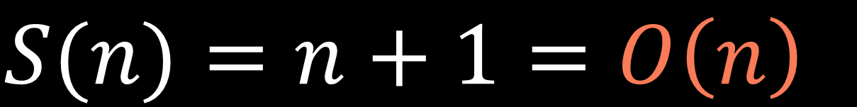
ways(n)
$$S(n)=n+1=O\left(n\right)$$
.
.
.
$$n+1$$
ways(1)
ways(0)

Slide 48
input:
s = "512810120129"
ways
(0)
ways
(1)
ways
(2)
ways
(3)
ways
(4)
ways
(5)
ways
(6)
ways
(7)
ways
(8)
ways
(9)
ways
(10)
ways
(11)
ways
(12)

Slide 49
input:
s = "512810120129"
ways
(0)
ways
(1)
ways
(2)
ways
(3)
ways
(4)
ways
(5)
ways
(6)
ways
(7)
ways
(8)
ways
(9)
ways
(10)
ways
(11)
ways
(12)

Slide 50
1
def ways(s, i=0, lookup=None): lookup = {} if lookup is None else lookup if i in lookup: return lookup[i] if i == len(s): return 1 elif s[i] == "0": return 0 elif i+1 < len(s) and "10" <= s[i]+s[i+1] <= "26": lookup[i] = ways(s, i+1, lookup) + ways(s, i+2, lookup) return lookup[i] else: lookup[i] = ways(s, i+1, lookup) return lookup[i]
2
3
4

Slide 51


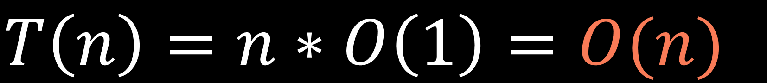
$$i∈\{0,1,…,n−1\}$$
$$n$$
$$T\left(n\right)=n∗O\left(1\right)=O(n)$$

Slide 52
$$S(n)=O\left(n\right)+O\left(n\right)=O(n)$$
call stack size
lookup table size

Slide 53



$$i∈\{0,1,…,n−1\}$$
$$n$$
$$n$$

Slide 54
dp[n-1] represents the number of ways to decode characters of s from index 0 to n-1 inclusive

Slide 55
dp[i] represents the number of ways to decode characters of s from index 0 to i inclusive

Slide 56
input:
s = "512810120129"
0
1
2
3
4
5
6
7
8
9
10
11

Slide 57
input:
s = "512810120129"
0
1
2
3
4
5
6
7
8
9
10
11
smallest subproblems

Slide 58
input:
s = "512810120129"
0
1
2
3
4
5
6
7
8
9
10
11

Slide 59
input:
s = "512810120129"
0
1
2
3
4
5
6
7
8
9
10
11
def ways(s): n = len(s) dp = [0]*n if s[0] == "0": return 0 elif len(s) == 1: return 1 dp[0] = 1 dp[1] = int(s[1] != "0") + int("10" <= s[0]+s[1] <= "26") for i in range(2, n): if s[i] != "0": dp[i] += dp[i-1] if "10" <= s[i-1]+s[i] <= "26": dp[i] += dp[i-2] return dp[n-1]

Slide 60
input:
s = "512810120129"
1
0
1
2
3
4
5
6
7
8
9
10
11
def ways(s): n = len(s) dp = [0]*n if s[0] == "0": return 0 elif len(s) == 1: return 1 dp[0] = 1 dp[1] = int(s[1] != "0") + int("10" <= s[0]+s[1] <= "26") for i in range(2, n): if s[i] != "0": dp[i] += dp[i-1] if "10" <= s[i-1]+s[i] <= "26": dp[i] += dp[i-2] return dp[n-1]
1 → A 2 → B 3 → C 4 → D 5 → E 6 → F 7 → G 8 → H 9 → I

Slide 61


input:
s = "512810120129"
1
0
1
2
3
4
5
6
7
8
9
10
11
def ways(s): n = len(s) dp = [0]*n if s[0] == "0": return 0 elif len(s) == 1: return 1 dp[0] = 1 dp[1] = int(s[1] != "0") + int("10" <= s[0]+s[1] <= "26") for i in range(2, n): if s[i] != "0": dp[i] += dp[i-1] if "10" <= s[i-1]+s[i] <= "26": dp[i] += dp[i-2] return dp[n-1]
$$s[1]≠"0"$$
$$"10"≤s\left[0\right]+s\left[1\right]≤"26"$$
?
?

Slide 62
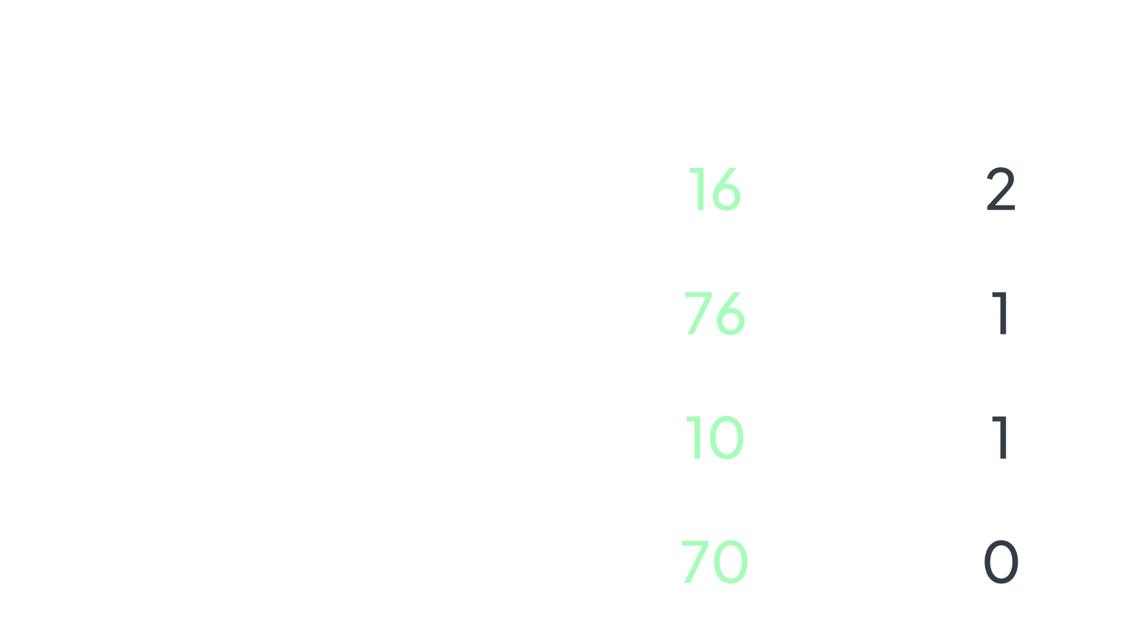
$$s[1] ≠ "0"$$ | $$"10"≤s\left[0\right]+s\left[1\right]≤"26"$$ | example | number of ways
 |  | 16 | 2
 |  | 76 | 1
 |  | 10 | 1
 |  | 70 | 0

Slide 63
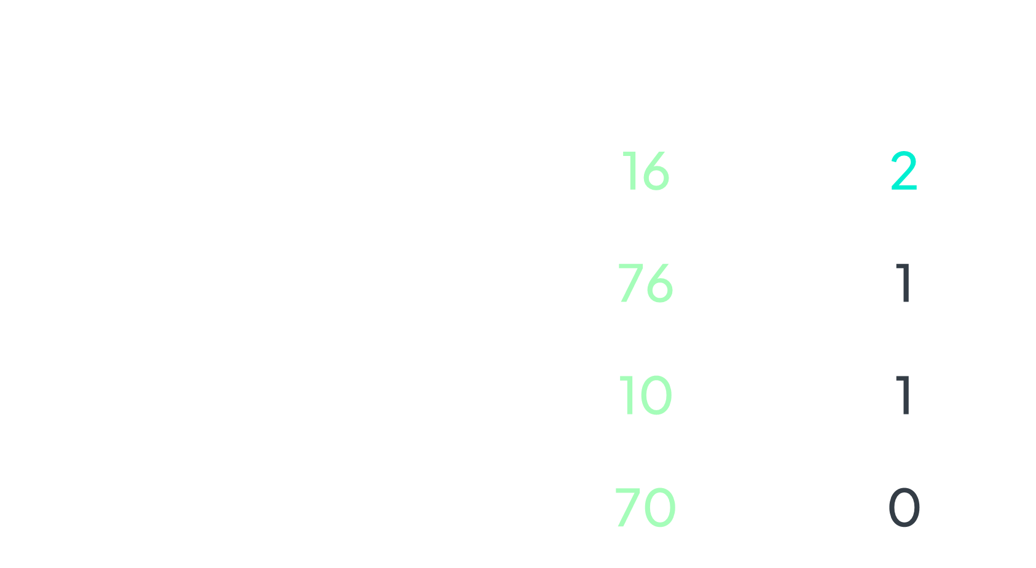
$$s[1] ≠ "0"$$ | $$"10"≤s\left[0\right]+s\left[1\right]≤"26"$$ | example | number of ways
 |  | 16 | 2
 |  | 76 | 1
 |  | 10 | 1
 |  | 70 | 0

Slide 64
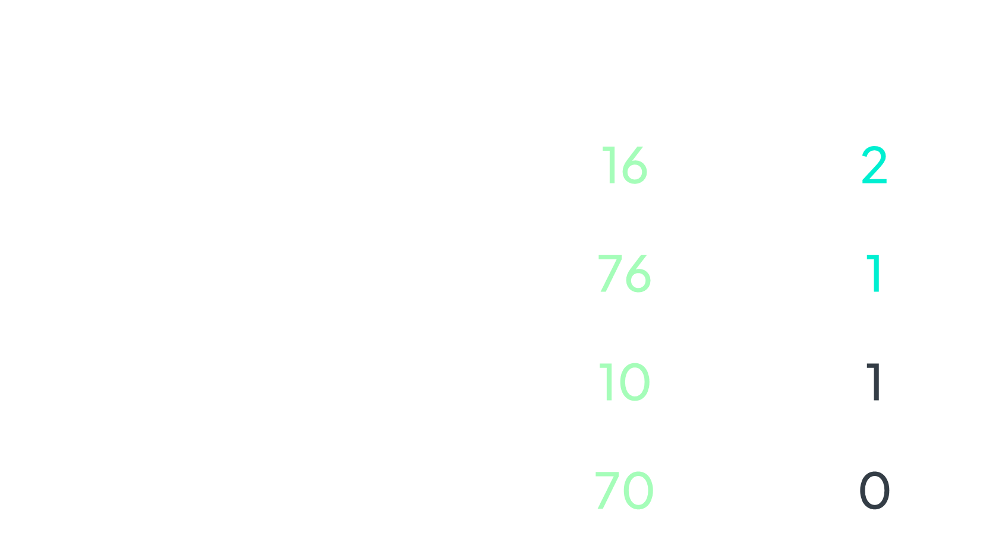
$$s[1] ≠ "0"$$ | $$"10"≤s\left[0\right]+s\left[1\right]≤"26"$$ | example | number of ways
 |  | 16 | 2
 |  | 76 | 1
 |  | 10 | 1
 |  | 70 | 0

Slide 65
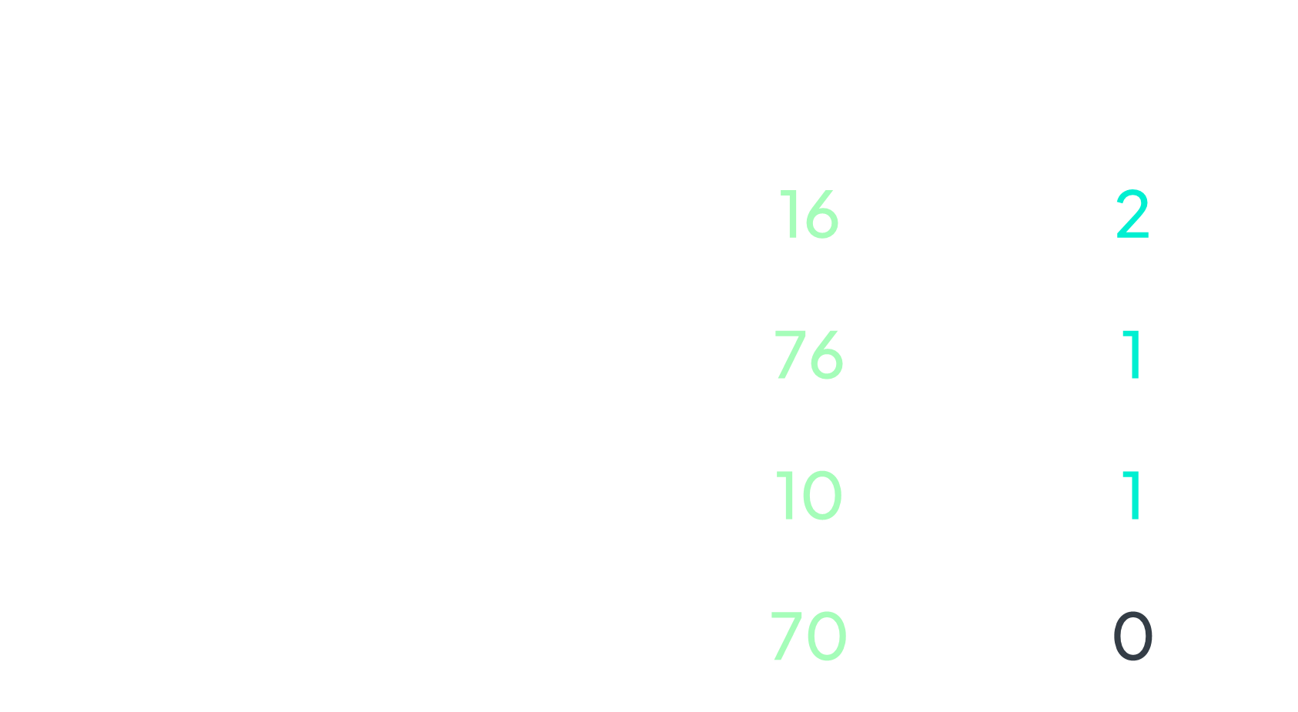
$$s[1] ≠ "0"$$ | $$"10"≤s\left[0\right]+s\left[1\right]≤"26"$$ | example | number of ways
 |  | 16 | 2
 |  | 76 | 1
 |  | 10 | 1
 |  | 70 | 0

Slide 66
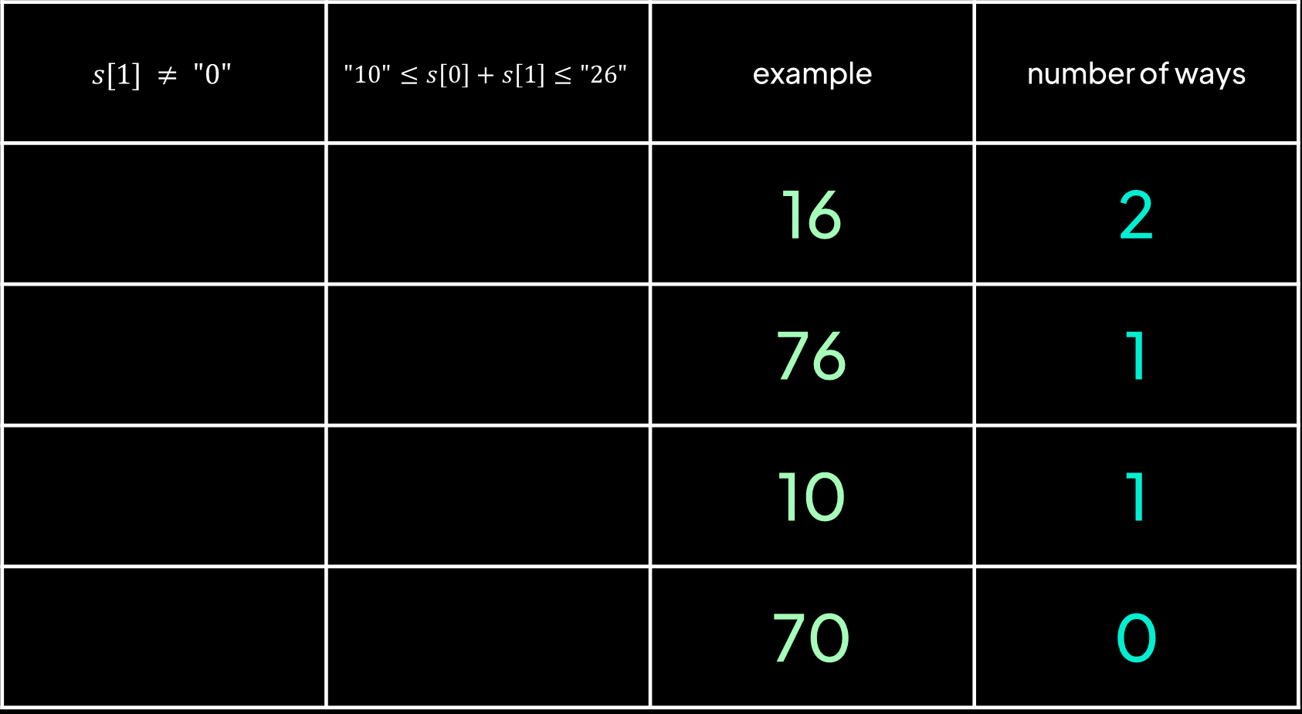
$$s[1] ≠ "0"$$ | $$"10"≤s\left[0\right]+s\left[1\right]≤"26"$$ | example | number of ways
 |  | 16 | 2
 |  | 76 | 1
 |  | 10 | 1
 |  | 70 | 0

Slide 67


input:
s = "512810120129"
1
1
0
1
2
3
4
5
6
7
8
9
10
11
def ways(s): n = len(s) dp = [0]*n if s[0] == "0": return 0 elif len(s) == 1: return 1 dp[0] = 1 dp[1] = int(s[1] != "0") + int("10" <= s[0]+s[1] <= "26") for i in range(2, n): if s[i] != "0": dp[i] += dp[i-1] if "10" <= s[i-1]+s[i] <= "26": dp[i] += dp[i-2] return dp[n-1]
$$s[1]≠"0"$$
$$"10"≤s\left[0\right]+s\left[1\right]≤"26"$$

Slide 68
input:
s = "512810120129"
To decode 512810120129:
i
We can either decode 512810120129 and decode 2
i-1
i
Or decode 512810120129 and decode 12
i-2
i-1
i

Slide 69
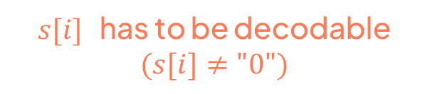
input:
s = "512810120129"
$s[i]$ has to be decodable $(s[i]≠"0")$
To decode 512810120129:
i
We can either decode 512810120129 and decode 2
i-1
i
Or decode 512810120129 and decode 12
i-2
i-1
i

Slide 70
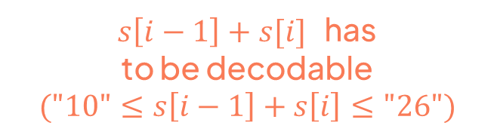
input:
s = "512810120129"
$s[i]$ has to be decodable $(s[i]≠"0")$
To decode 512810120129:
i
We can either decode 512810120129 and decode 2
i-1
i
Or decode 512810120129 and decode 12
i-2
i-1
i
$s\left[i−1\right]+s[i]$ has
to be decodable
$$("10"≤s\left[i−1\right]+s\left[i\right]≤"26")$$

Slide 71
input:
s = "512810120129"
1
1
0
1
2
3
4
5
6
7
8
9
10
11
def ways(s): n = len(s) dp = [0]*n if s[0] == "0": return 0 elif len(s) == 1: return 1 dp[0] = 1 dp[1] = int(s[1] != "0") + int("10" <= s[0]+s[1] <= "26") for i in range(2, n): if s[i] != "0": dp[i] += dp[i-1] if "10" <= s[i-1]+s[i] <= "26": dp[i] += dp[i-2] return dp[n-1]

Slide 72
input:
s = "512810120129"
1
1
0
1
2
3
4
5
6
7
8
9
10
11
def ways(s): n = len(s) dp = [0]*n if s[0] == "0": return 0 elif len(s) == 1: return 1 dp[0] = 1 dp[1] = int(s[1] != "0") + int("10" <= s[0]+s[1] <= "26") for i in range(2, n): if s[i] != "0": dp[i] += dp[i-1] if "10" <= s[i-1]+s[i] <= "26": dp[i] += dp[i-2] return dp[n-1]

Slide 73



input:
s = "512810120129"
i
1
1
0
1
2
3
4
5
6
7
8
9
10
11
def ways(s): n = len(s) dp = [0]*n if s[0] == "0": return 0 elif len(s) == 1: return 1 dp[0] = 1 dp[1] = int(s[1] != "0") + int("10" <= s[0]+s[1] <= "26") for i in range(2, n): if s[i] != "0": dp[i] += dp[i-1] if "10" <= s[i-1]+s[i] <= "26": dp[i] += dp[i-2] return dp[n-1]
$$s[i]≠"0"$$
$$"10"≤s\left[i−1\right]+s\left[i\right]≤"26"$$

Slide 74
input:
s = "512810120129"
i
1
1
2
0
1
2
3
4
5
6
7
8
9
10
11
def ways(s): n = len(s) dp = [0]*n if s[0] == "0": return 0 elif len(s) == 1: return 1 dp[0] = 1 dp[1] = int(s[1] != "0") + int("10" <= s[0]+s[1] <= "26") for i in range(2, n): if s[i] != "0": dp[i] += dp[i-1] if "10" <= s[i-1]+s[i] <= "26": dp[i] += dp[i-2] return dp[n-1]
$$s[i]≠"0"$$
$$"10"≤s\left[i−1\right]+s\left[i\right]≤"26"$$

Slide 75
input:
s = "512810120129"
i
1
1
2
0
1
2
3
4
5
6
7
8
9
10
11
def ways(s): n = len(s) dp = [0]*n if s[0] == "0": return 0 elif len(s) == 1: return 1 dp[0] = 1 dp[1] = int(s[1] != "0") + int("10" <= s[0]+s[1] <= "26") for i in range(2, n): if s[i] != "0": dp[i] += dp[i-1] if "10" <= s[i-1]+s[i] <= "26": dp[i] += dp[i-2] return dp[n-1]
$$s[i]≠"0"$$
$$"10"≤s\left[i−1\right]+s\left[i\right]≤"26"$$

Slide 76
input:
s = "512810120129"
i
1
1
2
2
0
1
2
3
4
5
6
7
8
9
10
11
def ways(s): n = len(s) dp = [0]*n if s[0] == "0": return 0 elif len(s) == 1: return 1 dp[0] = 1 dp[1] = int(s[1] != "0") + int("10" <= s[0]+s[1] <= "26") for i in range(2, n): if s[i] != "0": dp[i] += dp[i-1] if "10" <= s[i-1]+s[i] <= "26": dp[i] += dp[i-2] return dp[n-1]
$$s[i]≠"0"$$
$$"10"≤s\left[i−1\right]+s\left[i\right]≤"26"$$

Slide 77
input:
s = "512810120129"
i
1
1
2
2
0
1
2
3
4
5
6
7
8
9
10
11
def ways(s): n = len(s) dp = [0]*n if s[0] == "0": return 0 elif len(s) == 1: return 1 dp[0] = 1 dp[1] = int(s[1] != "0") + int("10" <= s[0]+s[1] <= "26") for i in range(2, n): if s[i] != "0": dp[i] += dp[i-1] if "10" <= s[i-1]+s[i] <= "26": dp[i] += dp[i-2] return dp[n-1]
$$s[i]≠"0"$$
$$"10"≤s\left[i−1\right]+s\left[i\right]≤"26"$$

Slide 78
input:
s = "512810120129"
i
1
1
2
2
2
0
1
2
3
4
5
6
7
8
9
10
11
def ways(s): n = len(s) dp = [0]*n if s[0] == "0": return 0 elif len(s) == 1: return 1 dp[0] = 1 dp[1] = int(s[1] != "0") + int("10" <= s[0]+s[1] <= "26") for i in range(2, n): if s[i] != "0": dp[i] += dp[i-1] if "10" <= s[i-1]+s[i] <= "26": dp[i] += dp[i-2] return dp[n-1]
$$s[i]≠"0"$$
$$"10"≤s\left[i−1\right]+s\left[i\right]≤"26"$$

Slide 79

input:
s = "512810120129"
i
1
1
2
2
2
0
1
2
3
4
5
6
7
8
9
10
11
def ways(s): n = len(s) dp = [0]*n if s[0] == "0": return 0 elif len(s) == 1: return 1 dp[0] = 1 dp[1] = int(s[1] != "0") + int("10" <= s[0]+s[1] <= "26") for i in range(2, n): if s[i] != "0": dp[i] += dp[i-1] if "10" <= s[i-1]+s[i] <= "26": dp[i] += dp[i-2] return dp[n-1]
$$s[i]≠"0"$$
$$"10"≤s\left[i−1\right]+s\left[i\right]≤"26"$$

Slide 80
input:
s = "512810120129"
i
1
1
2
2
2
2
0
1
2
3
4
5
6
7
8
9
10
11
def ways(s): n = len(s) dp = [0]*n if s[0] == "0": return 0 elif len(s) == 1: return 1 dp[0] = 1 dp[1] = int(s[1] != "0") + int("10" <= s[0]+s[1] <= "26") for i in range(2, n): if s[i] != "0": dp[i] += dp[i-1] if "10" <= s[i-1]+s[i] <= "26": dp[i] += dp[i-2] return dp[n-1]
$$s[i]≠"0"$$
$$"10"≤s\left[i−1\right]+s\left[i\right]≤"26"$$

Slide 81
input:
s = "512810120129"
i
1
1
2
2
2
2
0
1
2
3
4
5
6
7
8
9
10
11
def ways(s): n = len(s) dp = [0]*n if s[0] == "0": return 0 elif len(s) == 1: return 1 dp[0] = 1 dp[1] = int(s[1] != "0") + int("10" <= s[0]+s[1] <= "26") for i in range(2, n): if s[i] != "0": dp[i] += dp[i-1] if "10" <= s[i-1]+s[i] <= "26": dp[i] += dp[i-2] return dp[n-1]
$$s[i]≠"0"$$
$$"10"≤s\left[i−1\right]+s\left[i\right]≤"26"$$

Slide 82
input:
s = "512810120129"
i
1
1
2
2
2
2
2
0
1
2
3
4
5
6
7
8
9
10
11
def ways(s): n = len(s) dp = [0]*n if s[0] == "0": return 0 elif len(s) == 1: return 1 dp[0] = 1 dp[1] = int(s[1] != "0") + int("10" <= s[0]+s[1] <= "26") for i in range(2, n): if s[i] != "0": dp[i] += dp[i-1] if "10" <= s[i-1]+s[i] <= "26": dp[i] += dp[i-2] return dp[n-1]
$$s[i]≠"0"$$
$$"10"≤s\left[i−1\right]+s\left[i\right]≤"26"$$

Slide 83
input:
s = "512810120129"
i
1
1
2
2
2
2
2
0
1
2
3
4
5
6
7
8
9
10
11
def ways(s): n = len(s) dp = [0]*n if s[0] == "0": return 0 elif len(s) == 1: return 1 dp[0] = 1 dp[1] = int(s[1] != "0") + int("10" <= s[0]+s[1] <= "26") for i in range(2, n): if s[i] != "0": dp[i] += dp[i-1] if "10" <= s[i-1]+s[i] <= "26": dp[i] += dp[i-2] return dp[n-1]
$$s[i]≠"0"$$
$$"10"≤s\left[i−1\right]+s\left[i\right]≤"26"$$

Slide 84
input:
s = "512810120129"
i
1
1
2
2
2
2
2
4
0
1
2
3
4
5
6
7
8
9
10
11
def ways(s): n = len(s) dp = [0]*n if s[0] == "0": return 0 elif len(s) == 1: return 1 dp[0] = 1 dp[1] = int(s[1] != "0") + int("10" <= s[0]+s[1] <= "26") for i in range(2, n): if s[i] != "0": dp[i] += dp[i-1] if "10" <= s[i-1]+s[i] <= "26": dp[i] += dp[i-2] return dp[n-1]
$$s[i]≠"0"$$
$$"10"≤s\left[i−1\right]+s\left[i\right]≤"26"$$

Slide 85

input:
s = "512810120129"
i
1
1
2
2
2
2
2
4
0
1
2
3
4
5
6
7
8
9
10
11
def ways(s): n = len(s) dp = [0]*n if s[0] == "0": return 0 elif len(s) == 1: return 1 dp[0] = 1 dp[1] = int(s[1] != "0") + int("10" <= s[0]+s[1] <= "26") for i in range(2, n): if s[i] != "0": dp[i] += dp[i-1] if "10" <= s[i-1]+s[i] <= "26": dp[i] += dp[i-2] return dp[n-1]
$$s[i]≠"0"$$
$$"10"≤s\left[i−1\right]+s\left[i\right]≤"26"$$

Slide 86
input:
s = "512810120129"
i
1
1
2
2
2
2
2
4
2
0
1
2
3
4
5
6
7
8
9
10
11
def ways(s): n = len(s) dp = [0]*n if s[0] == "0": return 0 elif len(s) == 1: return 1 dp[0] = 1 dp[1] = int(s[1] != "0") + int("10" <= s[0]+s[1] <= "26") for i in range(2, n): if s[i] != "0": dp[i] += dp[i-1] if "10" <= s[i-1]+s[i] <= "26": dp[i] += dp[i-2] return dp[n-1]
$$s[i]≠"0"$$
$$"10"≤s\left[i−1\right]+s\left[i\right]≤"26"$$

Slide 87
input:
s = "512810120129"
i
1
1
2
2
2
2
2
4
2
0
1
2
3
4
5
6
7
8
9
10
11
def ways(s): n = len(s) dp = [0]*n if s[0] == "0": return 0 elif len(s) == 1: return 1 dp[0] = 1 dp[1] = int(s[1] != "0") + int("10" <= s[0]+s[1] <= "26") for i in range(2, n): if s[i] != "0": dp[i] += dp[i-1] if "10" <= s[i-1]+s[i] <= "26": dp[i] += dp[i-2] return dp[n-1]
$$s[i]≠"0"$$
$$"10"≤s\left[i−1\right]+s\left[i\right]≤"26"$$

Slide 88
input:
s = "512810120129"
i
1
1
2
2
2
2
2
4
2
2
0
1
2
3
4
5
6
7
8
9
10
11
def ways(s): n = len(s) dp = [0]*n if s[0] == "0": return 0 elif len(s) == 1: return 1 dp[0] = 1 dp[1] = int(s[1] != "0") + int("10" <= s[0]+s[1] <= "26") for i in range(2, n): if s[i] != "0": dp[i] += dp[i-1] if "10" <= s[i-1]+s[i] <= "26": dp[i] += dp[i-2] return dp[n-1]
$$s[i]≠"0"$$
$$"10"≤s\left[i−1\right]+s\left[i\right]≤"26"$$

Slide 89
input:
s = "512810120129"
i
1
1
2
2
2
2
2
4
2
2
0
1
2
3
4
5
6
7
8
9
10
11
def ways(s): n = len(s) dp = [0]*n if s[0] == "0": return 0 elif len(s) == 1: return 1 dp[0] = 1 dp[1] = int(s[1] != "0") + int("10" <= s[0]+s[1] <= "26") for i in range(2, n): if s[i] != "0": dp[i] += dp[i-1] if "10" <= s[i-1]+s[i] <= "26": dp[i] += dp[i-2] return dp[n-1]
$$s[i]≠"0"$$
$$"10"≤s\left[i−1\right]+s\left[i\right]≤"26"$$

Slide 90
input:
s = "512810120129"
i
1
1
2
2
2
2
2
4
2
2
4
0
1
2
3
4
5
6
7
8
9
10
11
def ways(s): n = len(s) dp = [0]*n if s[0] == "0": return 0 elif len(s) == 1: return 1 dp[0] = 1 dp[1] = int(s[1] != "0") + int("10" <= s[0]+s[1] <= "26") for i in range(2, n): if s[i] != "0": dp[i] += dp[i-1] if "10" <= s[i-1]+s[i] <= "26": dp[i] += dp[i-2] return dp[n-1]
$$s[i]≠"0"$$
$$"10"≤s\left[i−1\right]+s\left[i\right]≤"26"$$

Slide 91
input:
s = "512810120129"
i
1
1
2
2
2
2
2
4
2
2
4
0
1
2
3
4
5
6
7
8
9
10
11
def ways(s): n = len(s) dp = [0]*n if s[0] == "0": return 0 elif len(s) == 1: return 1 dp[0] = 1 dp[1] = int(s[1] != "0") + int("10" <= s[0]+s[1] <= "26") for i in range(2, n): if s[i] != "0": dp[i] += dp[i-1] if "10" <= s[i-1]+s[i] <= "26": dp[i] += dp[i-2] return dp[n-1]
$$s[i]≠"0"$$
$$"10"≤s\left[i−1\right]+s\left[i\right]≤"26"$$

Slide 92
input:
s = "512810120129"
i
1
1
2
2
2
2
2
4
2
2
4
4
0
1
2
3
4
5
6
7
8
9
10
11
def ways(s): n = len(s) dp = [0]*n if s[0] == "0": return 0 elif len(s) == 1: return 1 dp[0] = 1 dp[1] = int(s[1] != "0") + int("10" <= s[0]+s[1] <= "26") for i in range(2, n): if s[i] != "0": dp[i] += dp[i-1] if "10" <= s[i-1]+s[i] <= "26": dp[i] += dp[i-2] return dp[n-1]
$$s[i]≠"0"$$
$$"10"≤s\left[i−1\right]+s\left[i\right]≤"26"$$

Slide 93
input:
s = "512810120129"
1
1
2
2
2
2
2
4
2
2
4
4
0
1
2
3
4
5
6
7
8
9
10
11
def ways(s): n = len(s) dp = [0]*n if s[0] == "0": return 0 elif len(s) == 1: return 1 dp[0] = 1 dp[1] = int(s[1] != "0") + int("10" <= s[0]+s[1] <= "26") for i in range(2, n): if s[i] != "0": dp[i] += dp[i-1] if "10" <= s[i-1]+s[i] <= "26": dp[i] += dp[i-2] return dp[n-1]

Slide 94
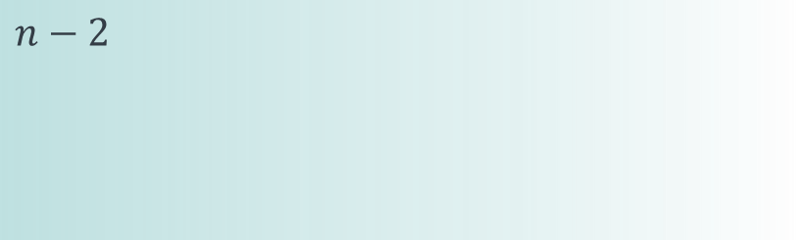

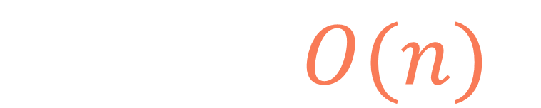
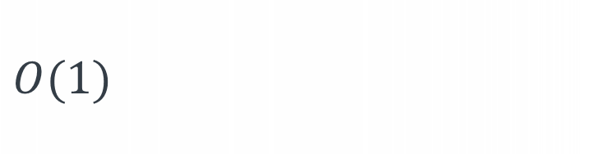
def ways(s): n = len(s) dp = [0]*n if s[0] == "0": return 0 elif len(s) == 1: return 1 dp[0] = 1 dp[1] = int(s[1] != "0") + int("10" <= s[0]+s[1] <= "26") for i in range(2, n): if s[i] != "0": dp[i] += dp[i-1] if "10" <= s[i-1]+s[i] <= "26": dp[i] += dp[i-2] return dp[n-1]
$$n$$
$$n−2$$
$$O(1)$$
$$T\left(n\right)=O(n)$$

Slide 95
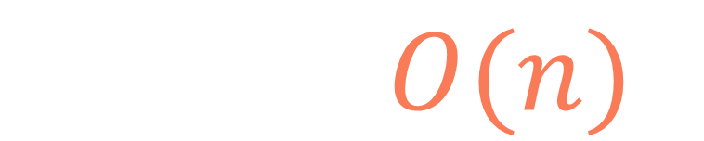
def ways(s): n = len(s) dp = [0]*n if s[0] == "0": return 0 elif len(s) == 1: return 1 dp[0] = 1 dp[1] = int(s[1] != "0") + int("10" <= s[0]+s[1] <= "26") for i in range(2, n): if s[i] != "0": dp[i] += dp[i-1] if "10" <= s[i-1]+s[i] <= "26": dp[i] += dp[i-2] return dp[n-1]
$$n$$
$$S\left(n\right)=O(n)$$

Slide 96
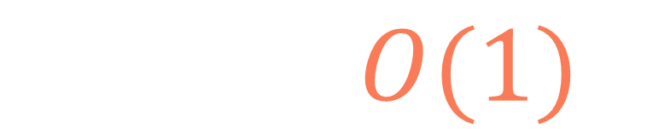



def ways(s): n = len(s) if s[0] == "0": return 0 elif len(s) == 1: return 1 before_prev_dp = 1 prev_dp = int(s[1] != "0") + int("10" <= (s[0]+s[1]) <= "26") for i in range(2, n): dp = 0 if s[i] != "0": dp += prev_dp if "10" <= (s[i-1]+s[i]) <= "26": dp += before_prev_dp before_prev_dp = prev_dp prev_dp = dp return prev_dp
$$1$$
$$1$$
$$1$$
$$S\left(n\right)=O(1)$$

Slide 97
Ways to decode
512810120129
m

